Slide 1

Dynamic programming

Slide 2
Dynamic Programming
The main use of dynamic programming is to solve optimization problems.
is a technique that breaks the problems into sub-problems, and saves the result for future purposes so that we do not need to compute the result again.
The subproblems are optimized to optimize the overall solution is known as optimal substructure property(optimality principle).

Slide 3
optimization problems mean that when we are trying to find out the minimum or the maximum solution of a problem.
The dynamic programming guarantees to find the optimal solution of a problem if the solution exists.
The definition of dynamic programming says that it is a technique for solving a complex problem by first breaking into a collection of simpler subproblems, solving each subproblem just once, and then storing their solutions to avoid repetitive computations.

Slide 4
example.
Consider an example of the Fibonacci series. The following series is the Fibonacci series:
0, 1, 1, 2, 3, 5, 8, 13, 21, 34, 55, 89, 144, ,…
Mathematically, we could write each of the terms using the below formula:
F(n) = F(n-1) + F(n-2),
With the base values F(0) = 0, and F(1) = 1. To calculate the other numbers, we follow the above relationship. For example, F(2) is the sum f(0) and f(1), which is equal to 1.

Slide 5
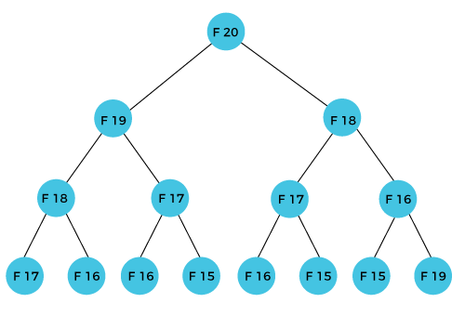
How can we calculate F(20)?
The F(20) term will be calculated using the nth formula of the Fibonacci series. The below figure shows that how F(20) is calculated.

Slide 6
As we can observe in the above figure that F(20) is calculated as the sum of F(19) and F(18).
In the dynamic programming approach, we try to divide the problem into the similar subproblems.
We are following this approach in the above case where F(20) into the similar subproblems, i.e., F(19) and F(18).
If we recap the definition of dynamic programming that it says the similar subproblem should not be computed more than once.
In the above example, F(18) is calculated two times; similarly, F(17) is also calculated twice.

Slide 7
In the above example, if we calculate the F(18) in the right subtree, then it leads to the tremendous usage of resources and decreases the overall performance.
The solution to the above problem is to save the computed results in an array.
First, we calculate F(16) and F(17) and save their values in an array.
The F(18) is calculated by summing the values of F(17) and F(16), which are already saved in an array.
The computed value of F(18) is saved in an array. The value of F(19) is calculated using the sum of F(18), and F(17), and their values are already saved in an array.
The computed value of F(19) is stored in an array.
The value of F(20) can be calculated by adding the values of F(19) and F(18), and the values of both F(19) and F(18) are stored in an array.
The final computed value of F(20) is stored in an array.

Slide 8
How does the dynamic programming approach work?
The following are the steps that the dynamic programming follows:
It breaks down the complex problem into simpler subproblems.
It finds the optimal solution to these sub-problems.
It stores the results of subproblems (memoization). The process of storing the results of subproblems is known as memorization.
It reuses them so that same sub-problem is calculated more than once.
Finally, calculate the result of the complex problem.

Slide 9
Comparison of Divide and Conquer vs Dynamic Programming

Slide 10
Comparison of Divide and Conquer vs Dynamic Programming
Divide and Conquer
divide-and-conquer algorithms partition the problem into disjoint subproblems
solve the subproblems recursively,
then combine their solutions to solve the original problem
a divide-and-conquer algorithm does more work than necessary, repeatedly solving the common subproblems.
Divide-and-conquer algorithms can be thought of as top-down algorithms

Slide 11
Dynamic programming
Dynamic programming solves problems by combining the solutions to subproblems.
dynamic programming applies when the subproblems overlap—that is, when subproblems share sub subproblems.,
A dynamic-programming algorithm solves each subproblem just once and then saves its answer in a table, thereby avoiding the work of recomputing the answer every time it solves each subsubproblem.
Dynamic programming can be thought of as bottom-up

Slide 12
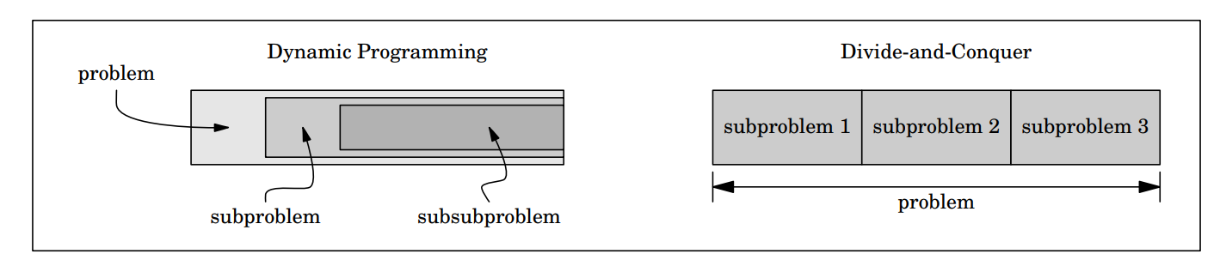

Slide 13
When developing a dynamic-programming algorithm, we follow a sequence of four steps:
1. Characterize the structure of an optimal solution.
2. Recursively define the value of an optimal solution.
3. Compute the value of an optimal solution, typically in a bottom-up fashion.
4. Construct an optimal solution from computed information.

Slide 14
Steps 1–3 form the basis of a dynamic-programming solution to a problem.
If we need only the value of an optimal solution, and not the solution itself, then we can omit step 4.

Slide 15
The principle of optimality
The principle of optimality is the basic principle of dynamic programming, which was developed by Richard Bellman:
The principle of optimality applies if the optimal solution to a problem always contains optimal solutions to all subproblems

Slide 16
all-pairs shortest paths problem (Floyd-Warshall algorithm)

Slide 17
The all pair shortest path algorithm is also known as Floyd-Warshall algorithm
Floyd-Warhshall algorithm is also called as Floyd's algorithm, Roy-Floyd algorithm, Roy-Warshall algorithm, or WFI algorithm.
It is used to find all pair shortest path from a given weighted graph.
result of this algorithm, it will generate a matrix, which will represent the minimum distance from any node to all other nodes in the graph.

Slide 18
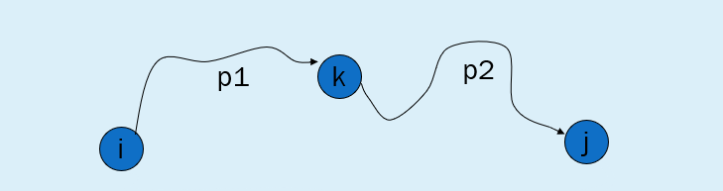
Let G = (V, E) be a directed graph with n vertices.
Let cost be a cost adjacency matrix for G such that
cost(i,i)= 0, 1< i < n.
The cost(i,j) is the length (or cost) of edge(i,j) if (i,j) Ꞓ (G) and cost(i,j)= ∞ if(i j ) not in E(G).
Principle of optimality :
If k is the node on the shortest path from i to j, then the path from i to k and k to j, must also be shortest.

Slide 19
Let us examine a shortest i to j path in G .This path originates at vertex i and goes through some intermediate vertices(possibly none)and Terminates at vertex j.
If k is an intermediate vertex on this shortest path, then ,the sub paths from i to k and from k to j must be shortest paths from i to k and k to j, respectively.Otherwise,the i to j path is not of minimum length.
So,the principle of optimality holds.This alerts us to the prospect of using dynamic programming

Slide 20
All intermediate vertices in {1,2,…,k-1}
p1
k
p2
i
j
P:all intermediate vertices in {1,2,…,k}
Path p is a shortest path from vertex i to vertex j and k is the highest-numbered
intermediate vertex of p. Path p1, the portion of path p from vertex i to vertex k,has all intermediate vertices in the set {1,2,…,k-1}.The same holds for path p2 from vertex k to vertex j.

Slide 21
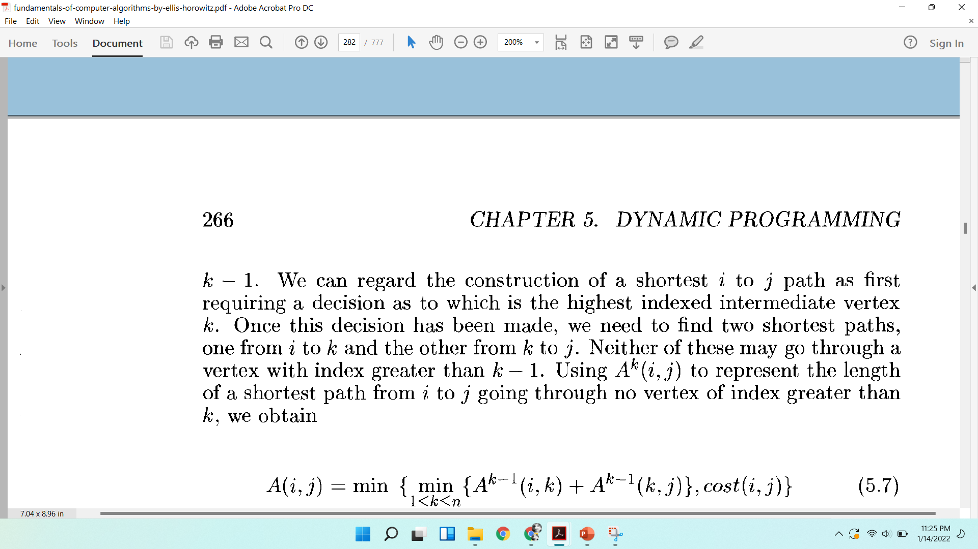
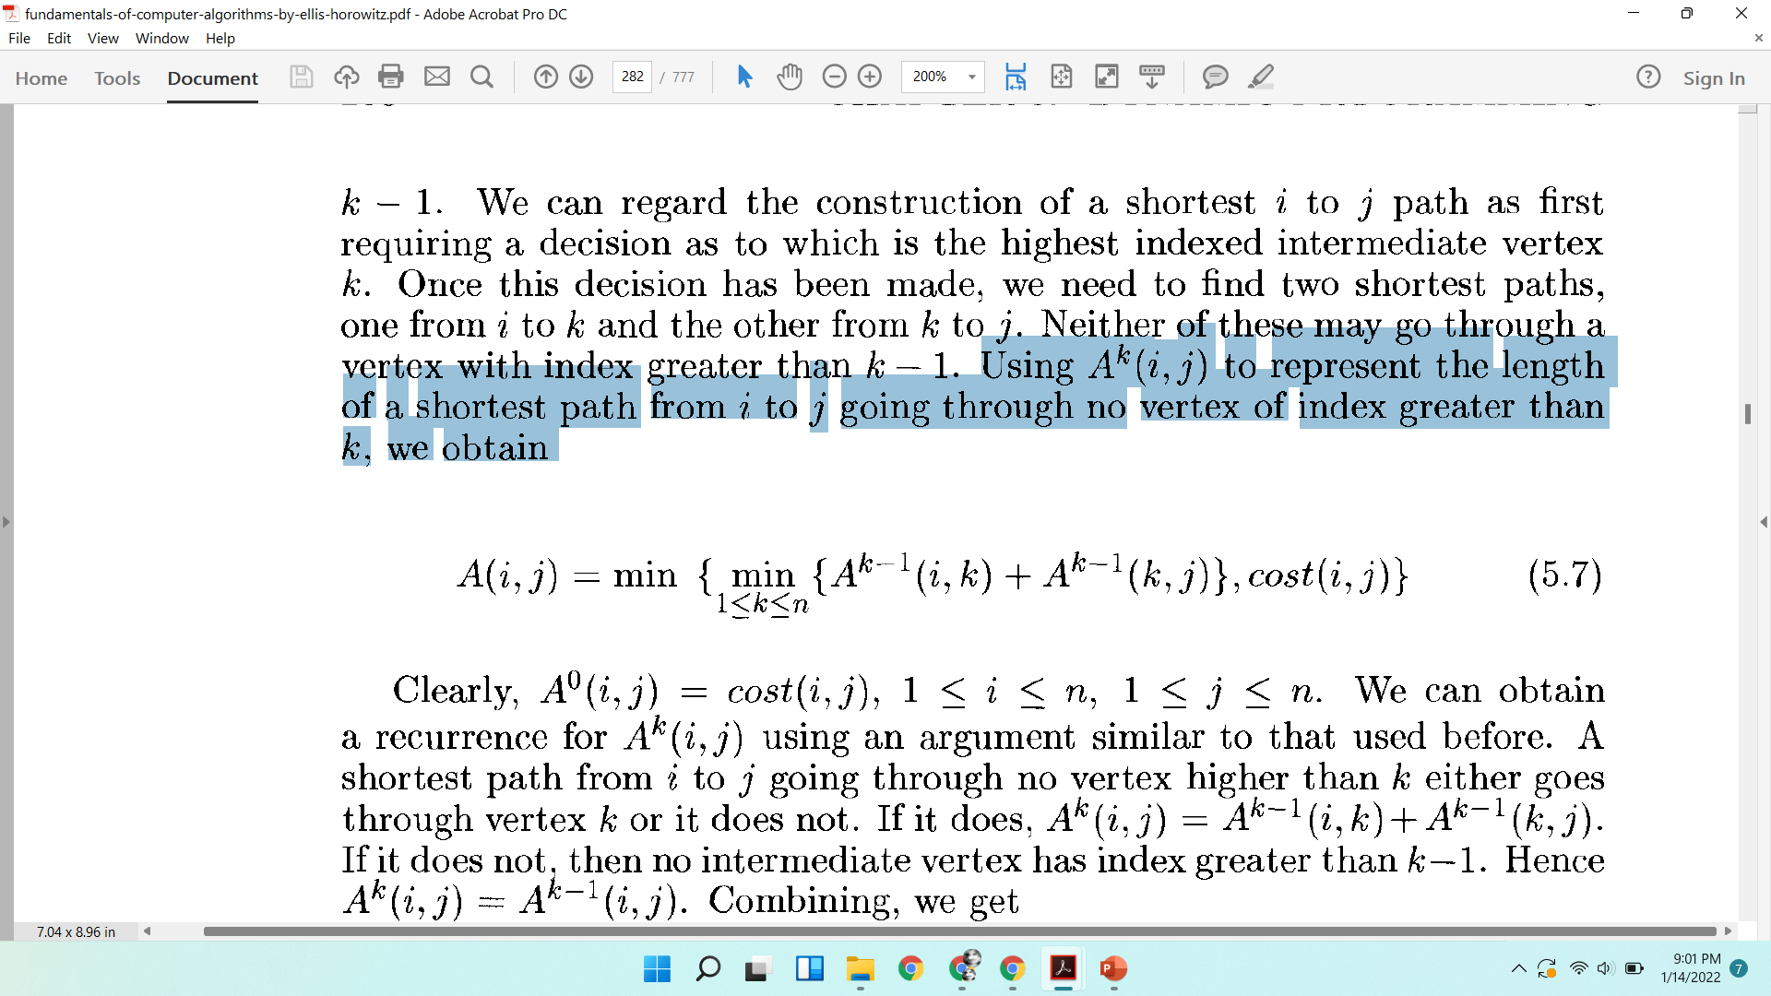
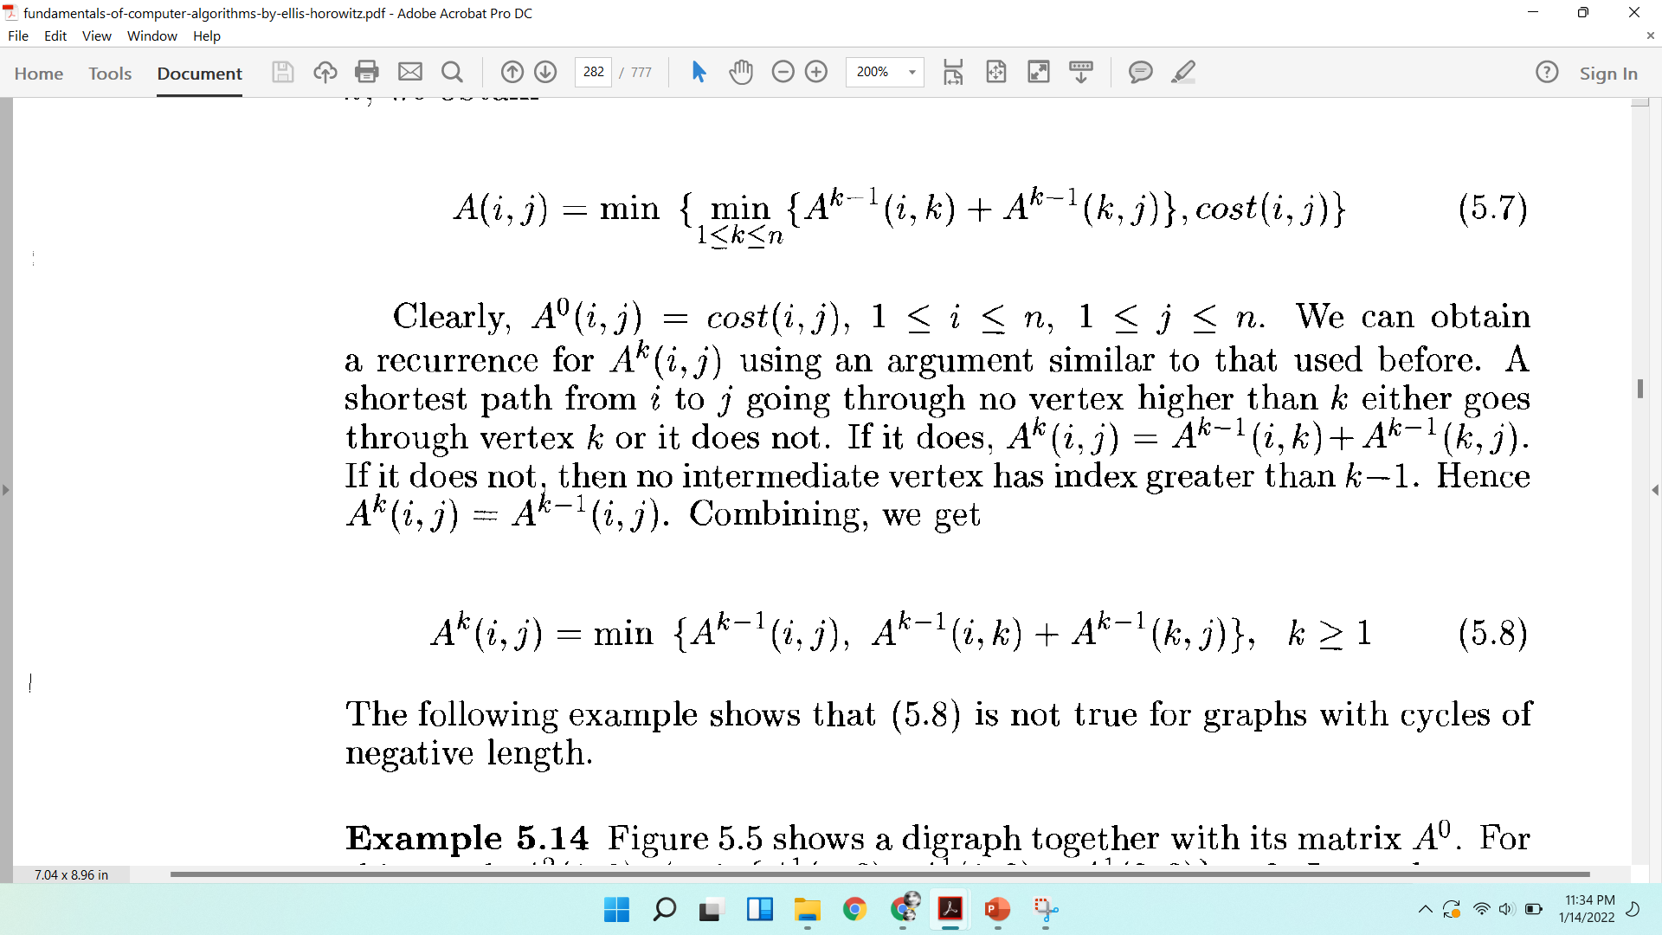
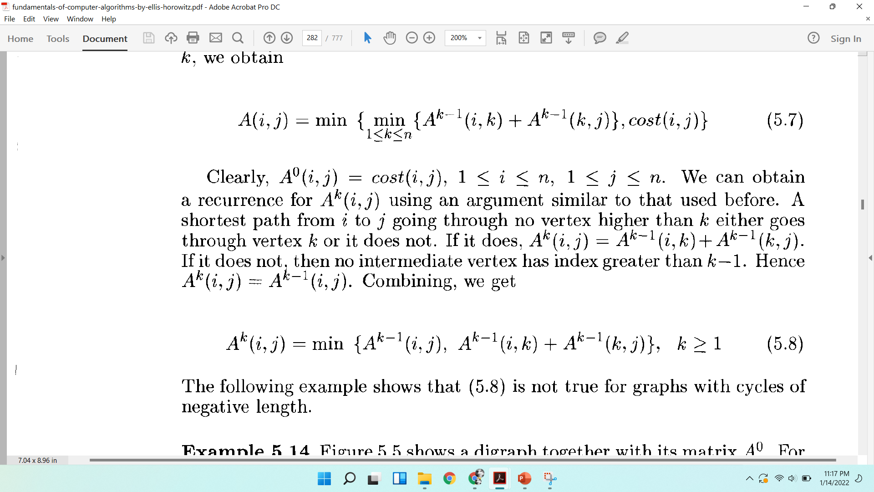
Similarly the k to j path is a shortest k to j path in G going through no vertex of index greater than k=1.
Using to represent the length of a shortest path from i to j going through no vertex of index greater than k, we obtain

Slide 22
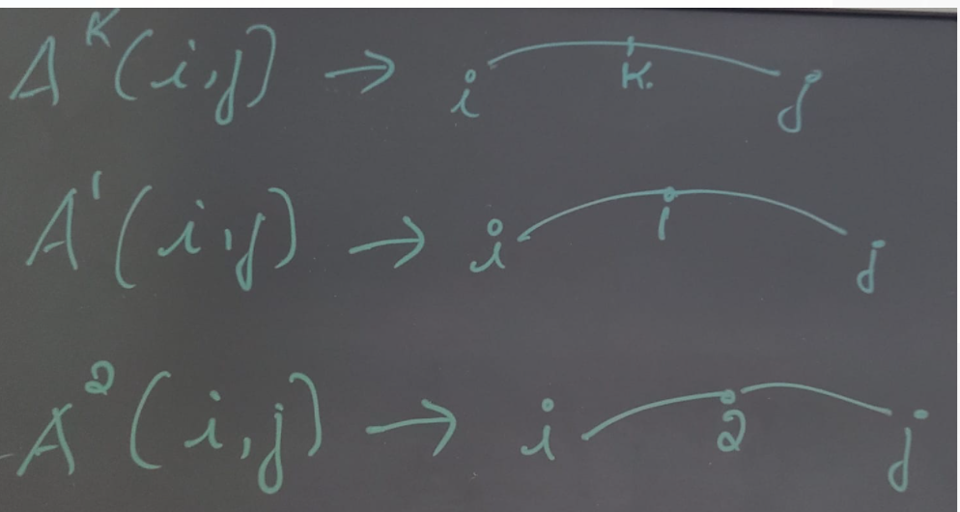

Slide 23
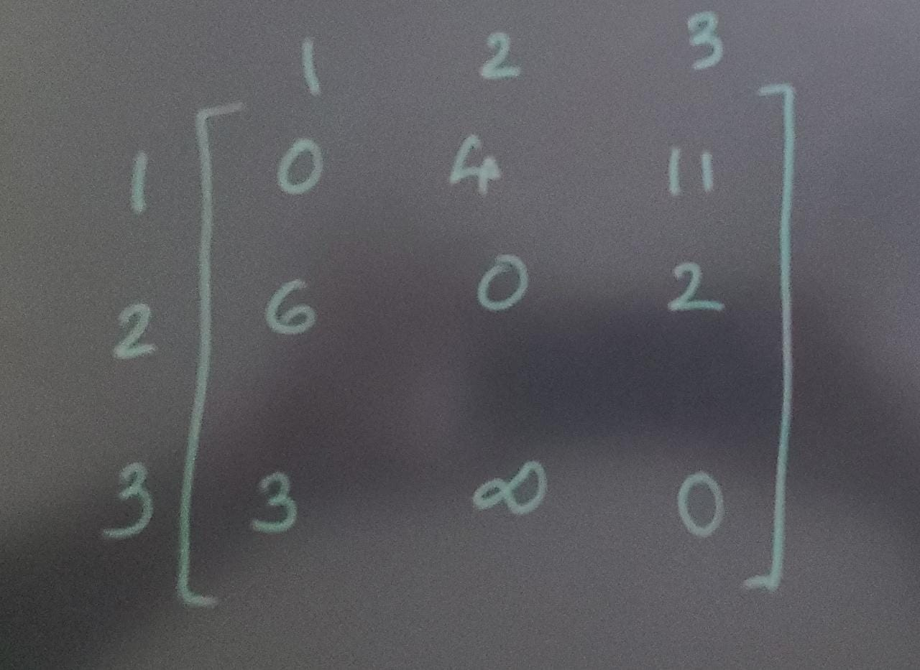
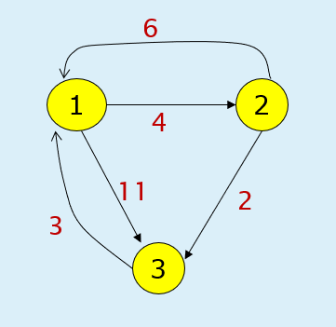
Example

Slide 24
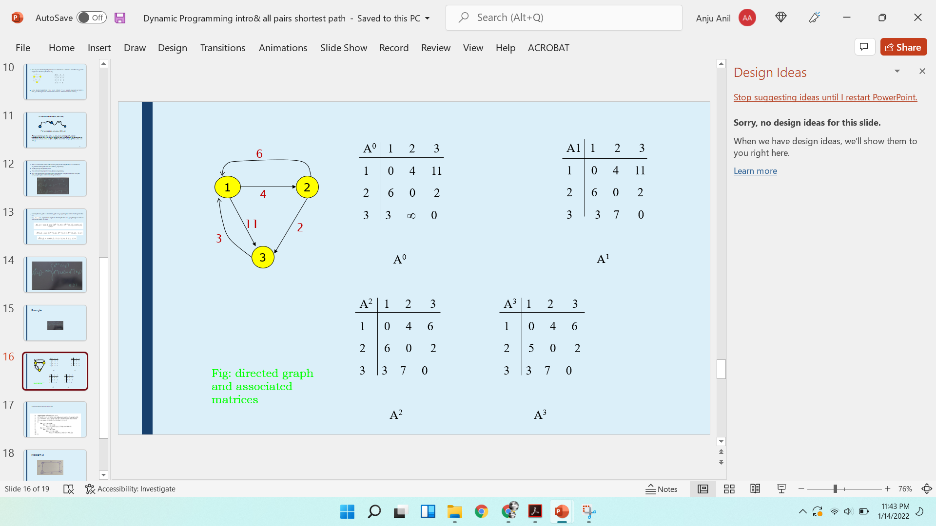
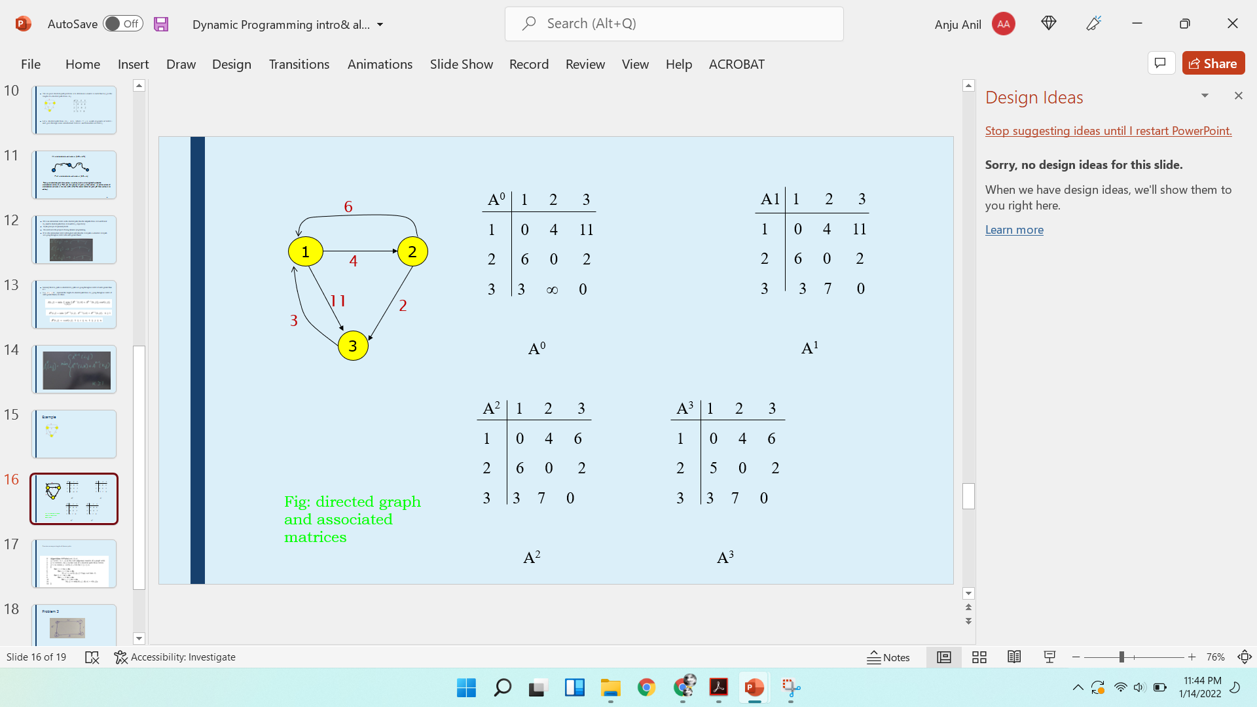
Example

Slide 25
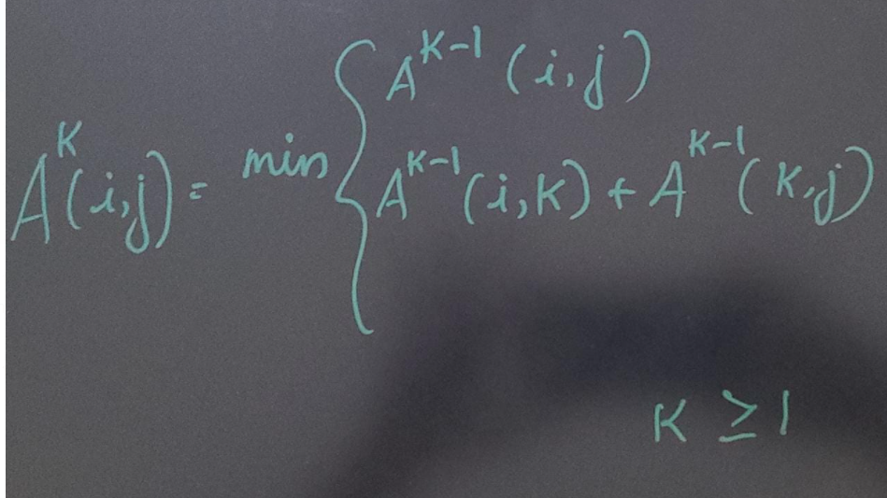

Slide 26
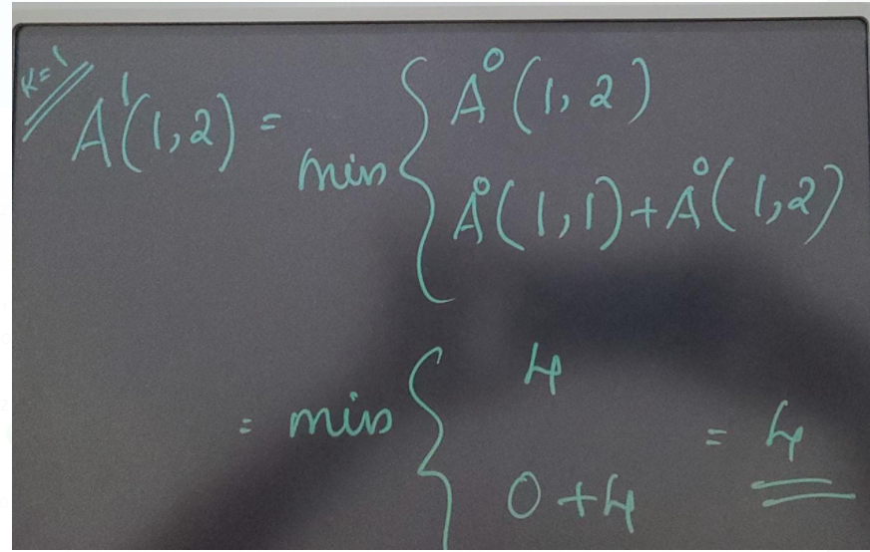
k=1 ,that means Intermate vertex is 1

Slide 27
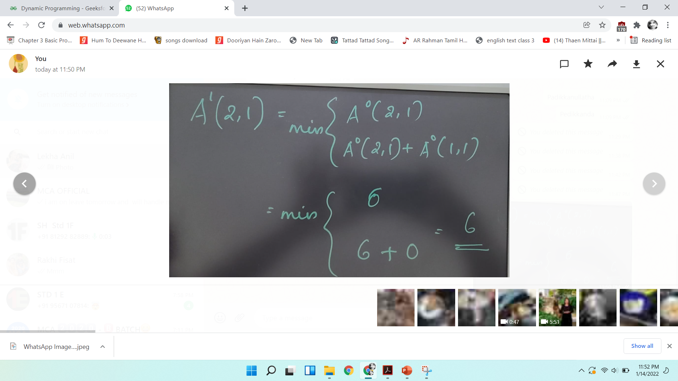
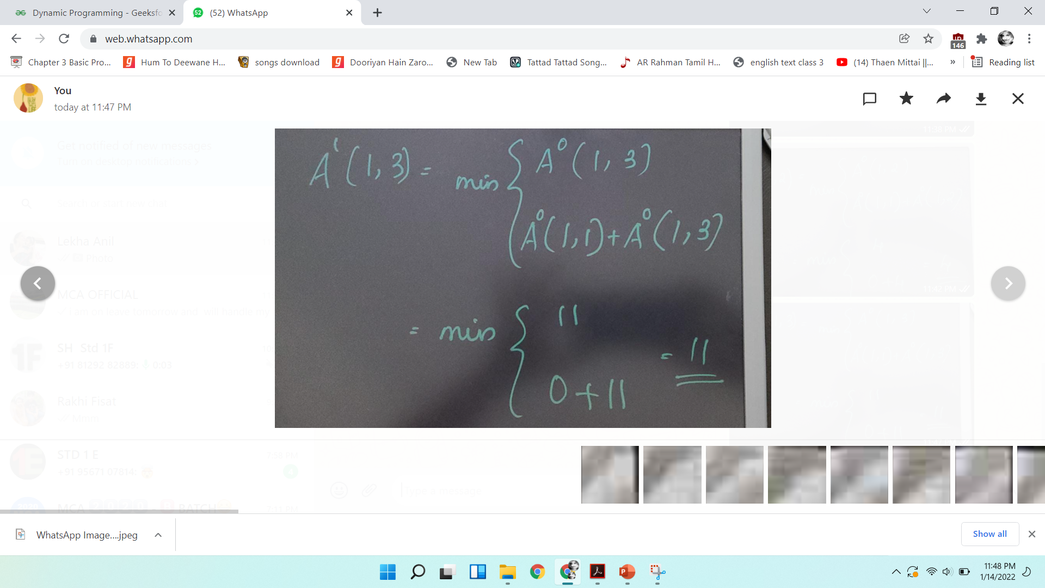
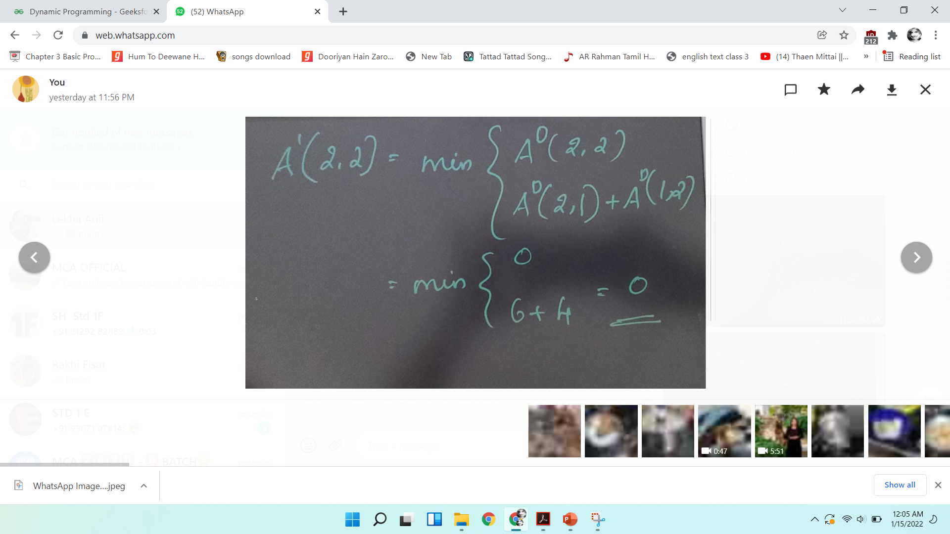
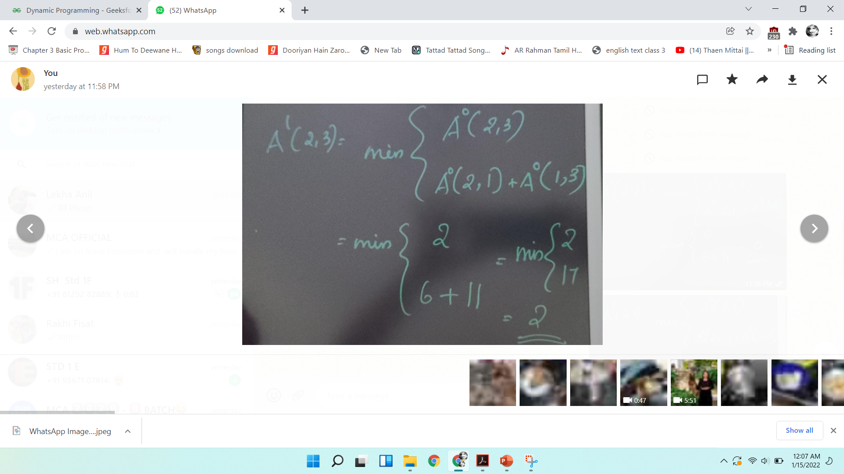


Slide 28
A⁰ 1 2 3
1 0 4 11
2 6 0 2
3 ∞ 0
A⁰
A1 1 2 3
1 0 4 11
2 6 0 2
3 7 0
A¹
6
1
2
4
11
2
3
3
A² 1 2 3
1 0 4 6
2 6 0 2
3 7 0
A²
A³ 1 2 3
1 0 4 6
2 5 0 2
3 7 0
A³
Fig: directed graph and associated matrices

Slide 29
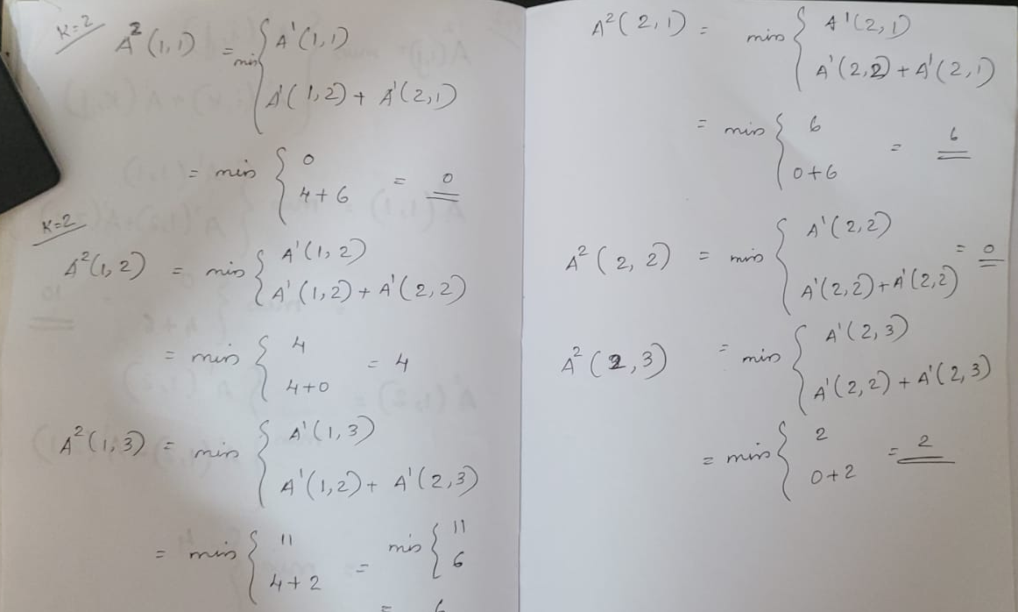

Slide 30
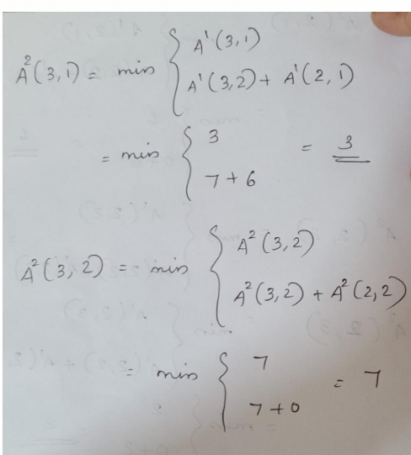

Slide 31
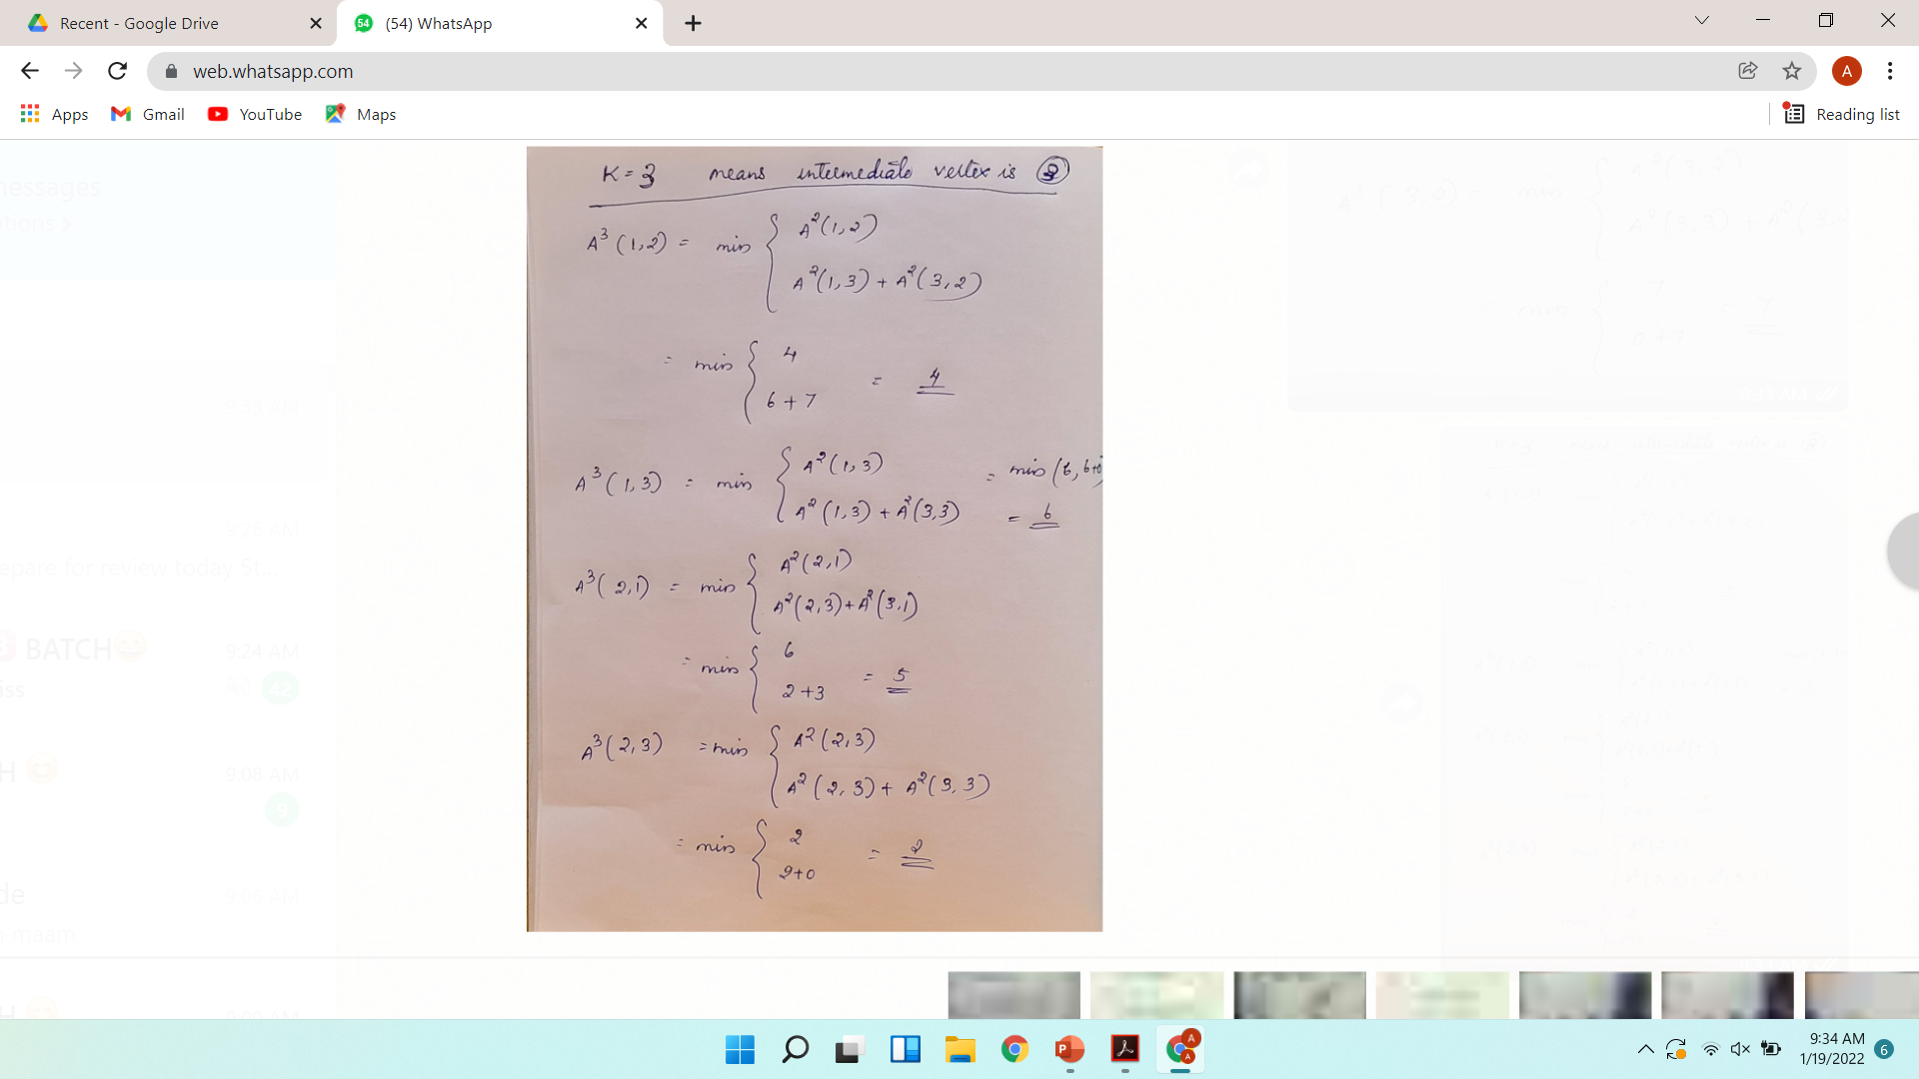
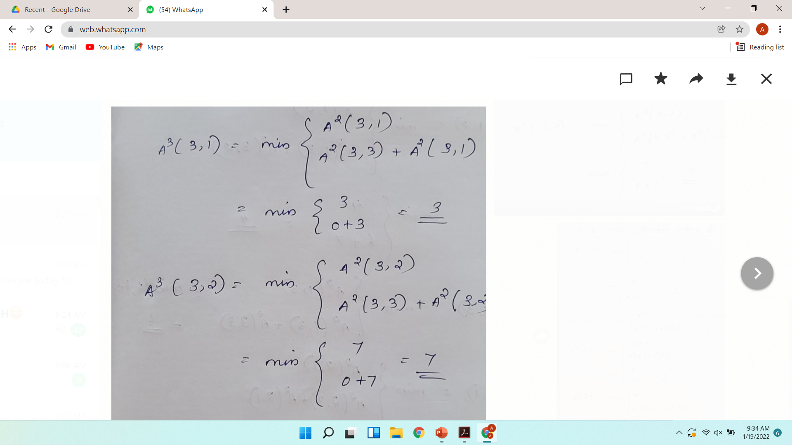

Slide 32
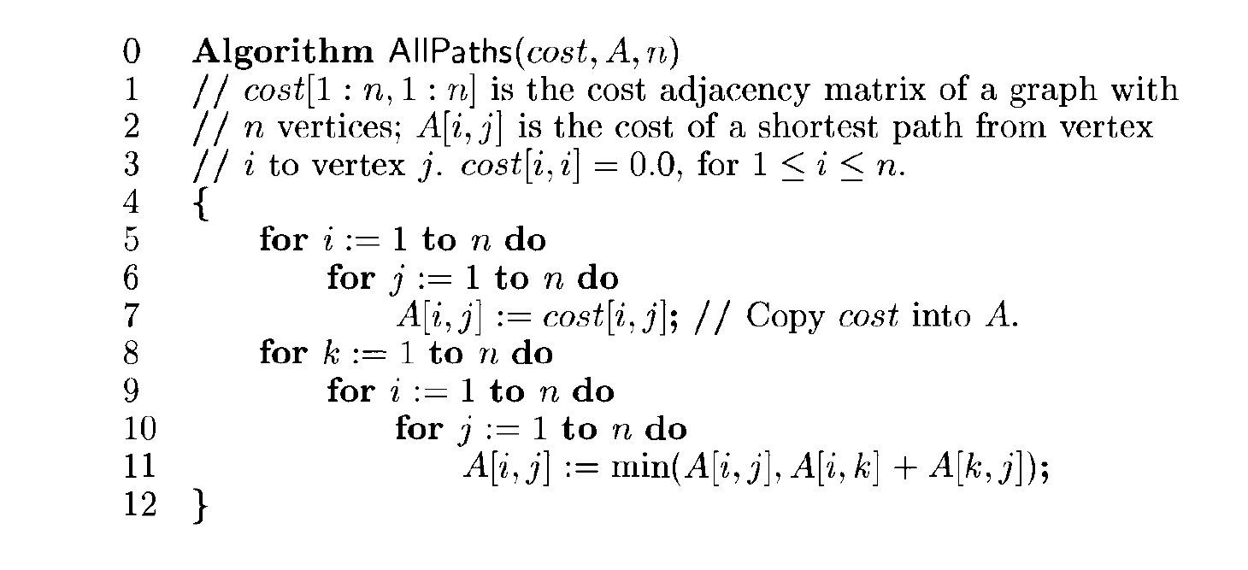
Function to compute lengths of shortest paths

Slide 33
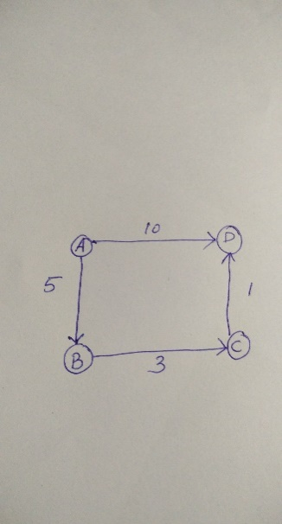
Problem 2

Slide 34
Output: Shortest distance matrix 0 5 8 9 ∞ 0 3 4 ∞ ∞ 0 1 ∞ ∞ ∞ 0

